Slide 1

TRANSFER LEARNING BASED MEDICAL IMAGE ANALYSIS
Presented By : Shubhi Agarwal

Slide 2
1
CANCER
Cancer is a complex group of diseases characterized by the uncontrolled growth and spread of abnormal cells in the body, affecting almost any organ or tissue.
The causes of cancer are multifactorial, including genetic mutations, environmental exposures, lifestyle factors, and infections. These factors can lead to alterations in normal cell growth and division, ultimately resulting in the formation of tumors or malignancies.
The advent of Machine Learning (ML) in cancer research and treatment has revolutionized the field, offering significant improvements in early detection, diagnosis, and personalized treatment.
Globally, the top five cancers in terms of incidence and mortality are: Breast cancer, lung cancer, colorectal cancer, prostate cancer, skin cancer
https://www.who.int/news-room/fact-sheets/detail/cancer
https://www.cancer.org/research/cancer-facts-statistics/all-cancer-facts-figures/2024-cancer-facts-figures.html

Slide 3
SKIN CANCER

Slide 4
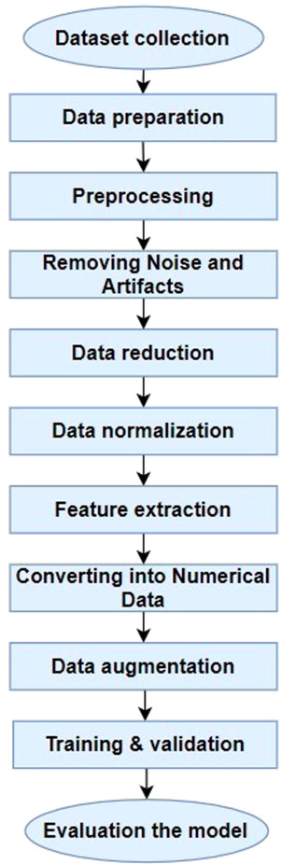
SKIN CANCER
3
An enhanced technique of skin cancer classification using deep convolutional neural network with transfer learning models
Goal : classification between benign and malignant skin lesions
Model | Precision | Recall | F1 score | Training Acc | Testing Acc | Time/epoch
AlexNet (Han et al., 2017) | 97.88 | 92.01 | 94.85 | 93.82 | 90.86 | 14-16 s
ResNet (Targ et al., 2016) | 96.00 | 93.63 | 94.80 | 91.25 | 90.93 | 13-15 s
VGG-16 (Guan et al., 2019) | 1.00 | 86.02 | 92.48 | 86.17 | 86.02 | 14-15 s
DenseNet (Carcagnì et al., 2019) | 91.42 | 94.83 | 93.09 | 91.64 | 88.33 | 16-18 s
MobileNet (Sinha & El-Sharkawy, 2019) | 92.08 | 94.15 | 93.10 | 90.31 | 88.26 | 11-12 s
Proposed DCNN model | 96.57 | 93.66 | 95.09 | 93.16 | 91.43 | 9-10 s
https://www.sciencedirect.com/science/article/pii/S2666827021000177#b15

Slide 5
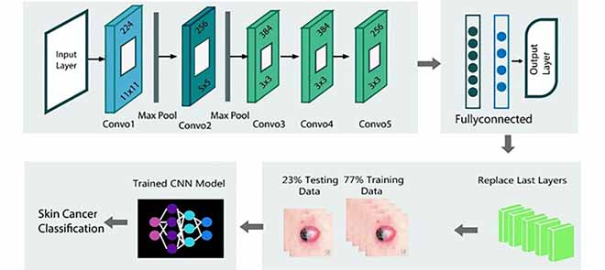
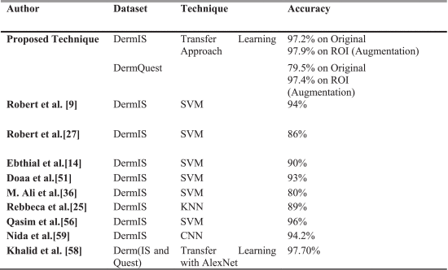
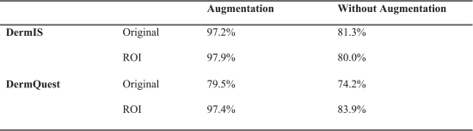
4
Region-of-Interest Based Transfer Learning Assisted Framework for Skin Cancer Detection
Goal : Skin cancer classification based on Region on interest
https://ieeexplore.ieee.org/document/9160933

Slide 6
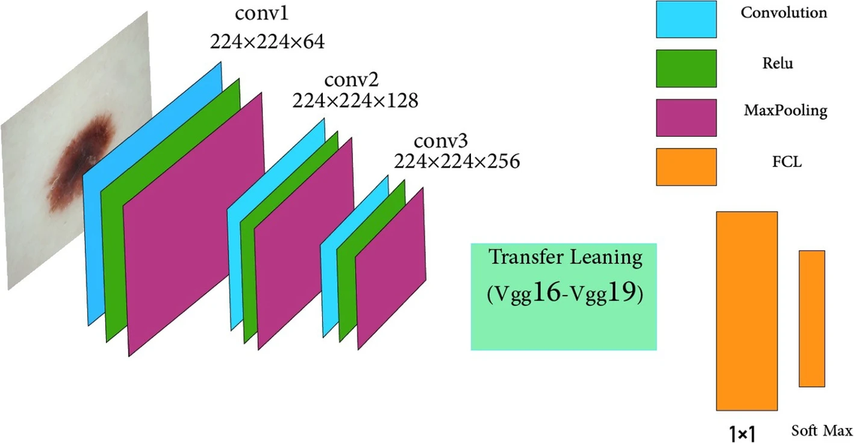
SKIN CANCER
5
Diagnosis of skin cancer using VGG16 and VGG19 based transfer learning models
Goal : classification between benign and malignant skin lesions
Employing k-fold the accuracy of 97.51% for the VGG-16 architecture and 98.1% for the VGG-19 architecture have been achieved.
Comparision with other models : https://link.springer.com/article/10.1007/s11042-023-17735-2/tables/2
https://link.springer.com/article/10.1007/s11042-023-17735-2

Slide 7
BREAST CANCER

Slide 8
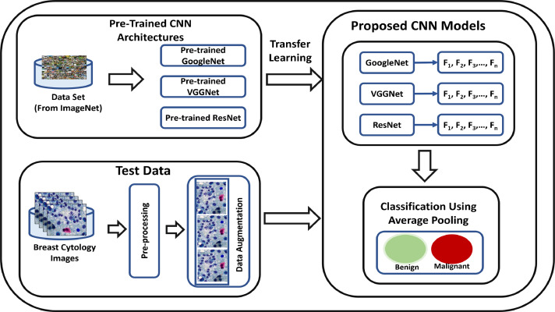
BREAST CANCER
7
A novel deep learning based framework for the detection and classification of breast cancer using transfer learning
Goal : detection and classification of breast cancer
CNN Architectures | Lens | Magnification | Magnification | Magnification | Average Classification Accuracies
 | 100X | 140X | 200X | 500X
GoogLeNet | 90.4 | 93.7 | 95.3 | 94.6 | 93.5%
VGGNet | 90.8 | 94.8 | 96.7 | 94.2 | 94.15%
ResNet | 91.5 | 93.3 | 95.4 | 97.2 | 94.35%
Proposed Framework | 96.8 | 96.9 | 97.8 | 98.6 | 97.525%
https://www.sciencedirect.com/science/article/pii/S0167865519301059

Slide 9
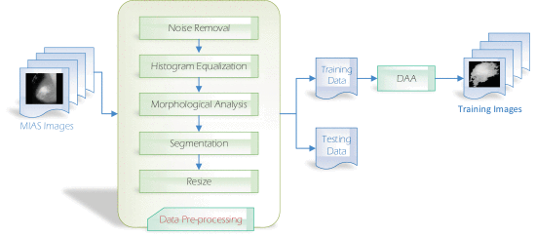
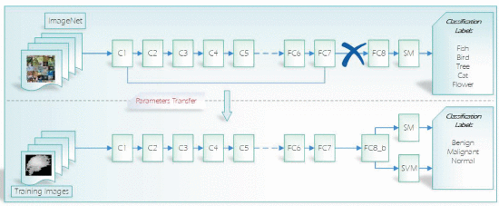
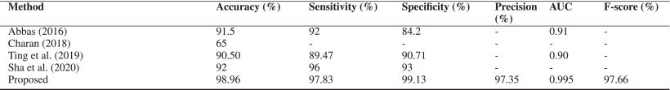
BREAST CANCER
8
A Novel Deep-Learning Model for Automatic Detection and Classification of Breast Cancer Using the Transfer-Learning Technique
Goal : automatic detection and diagnosis of the BC suspected area (Detection and Classification)
https://ieeexplore.ieee.org/abstract/document/9427477

Slide 10
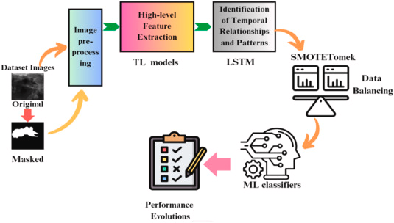
BREAST CANCER
9
Fusion of transfer learning models with LSTM for detection of breast cancer using ultrasound images
Goal : automatic detection and diagnosis of the BC suspected area (Detection and Classification), also considered imbalanced dataset.
TL models | KAbc | KPbc | KRbc | KFbc | KMbc | KKbc
Xception | 84.1 % | 88.8 % | 86.4 % | 87.2 % | 80.9 % | 80.6 %
NASNetMobile | 89.8 % | 89.1 % | 87.2 % | 87.8 % | 81.3 % | 81.0 %
InceptionResNetV2 | 94.5 % | 88.6 % | 88.7 % | 88.4 % | 81.7 % | 81.4 %
MobileNetV2 | 86.0 % | 88.7 % | 86.1 % | 86.7 % | 79.7 % | 78.9 %
ResNet50 | 79.6 % | 81.3 % | 68.1 % | 70.1 % | 60.1 % | 55.6 %
VGG16 | 87.2 % | 88.8 % | 87.1 % | 87.8 % | 81.4 % | 81.2 %
VGG16-LSTM with SMOTETomek-LR-L | 96.1 % | 96.1 % | 96.3 % | 96.0 % | 94.2 % | 94.1 %
https://www.sciencedirect.com/science/article/pii/S0010482523013793

Slide 11
LUNG CANCER

Slide 12
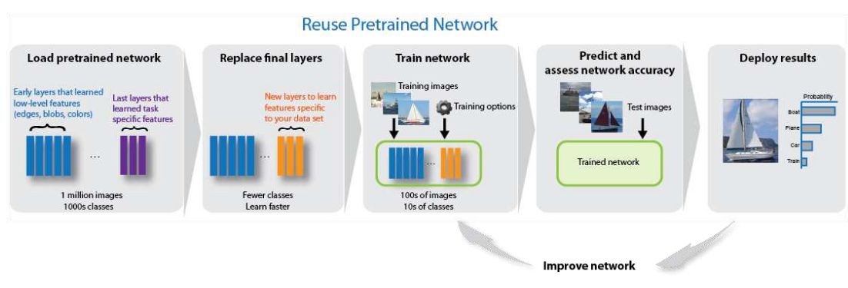
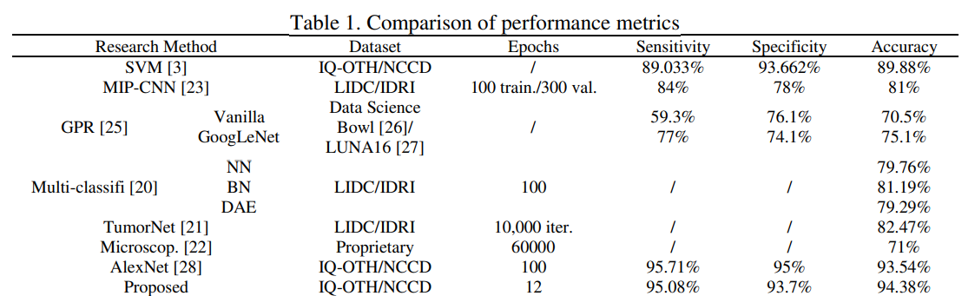
LUNG CANCER
10
Transfer learning with GoogLeNet for detection of lung cancer
Goal : classification of lung cancer using ROI, GoogleLeNet
Link to the paper

Slide 13
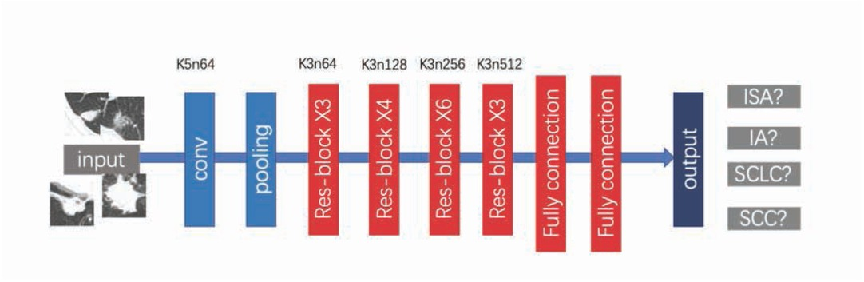
LUNG CANCER
11
Classification of pathological types of lung cancer from CT images by deep residual neural networks with transfer learning strategy
Goal : classification of lung cancer using ROI, GoogleLeNet
AlexNet[26] | VGG16[27] | DenseNet[28] | Ours without transfer learning | Ours with transfer learning
63.980.10 | 78.42 | 80.7.89 | 79.532.64 | 85.71.29
https://www.degruyter.com/document/doi/10.1515/med-2020-0028/html

Slide 14
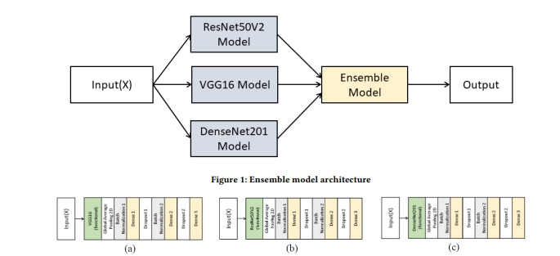
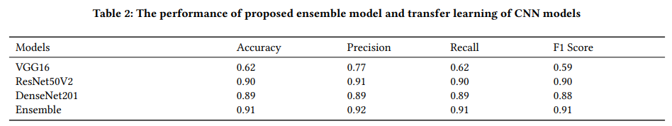
LUNG CANCER
12
Ensemble Transfer Learning for Lung Cancer
Goal : detection and classification of lung cancer
https://dl.acm.org/doi/pdf/10.1145/3478905.3478995

Slide 15
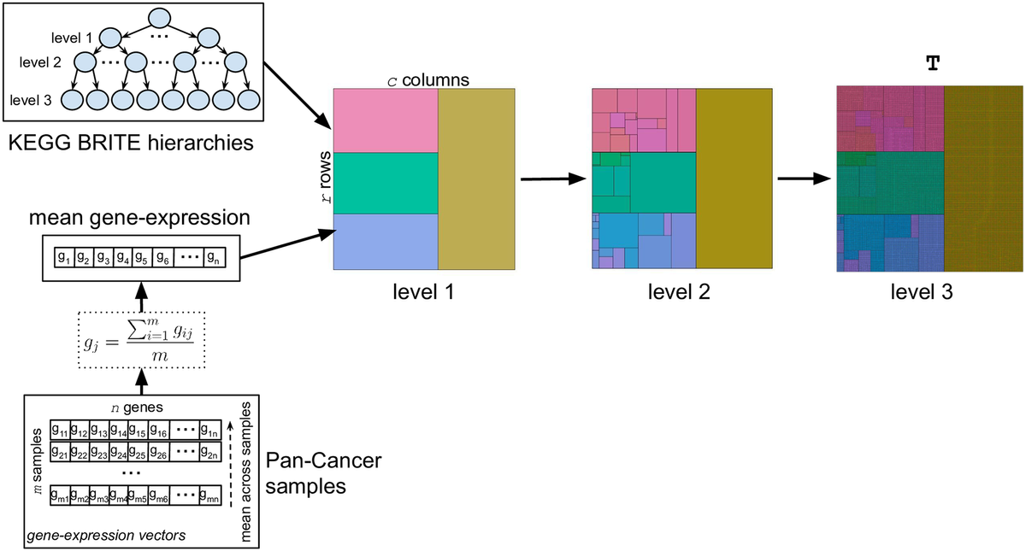
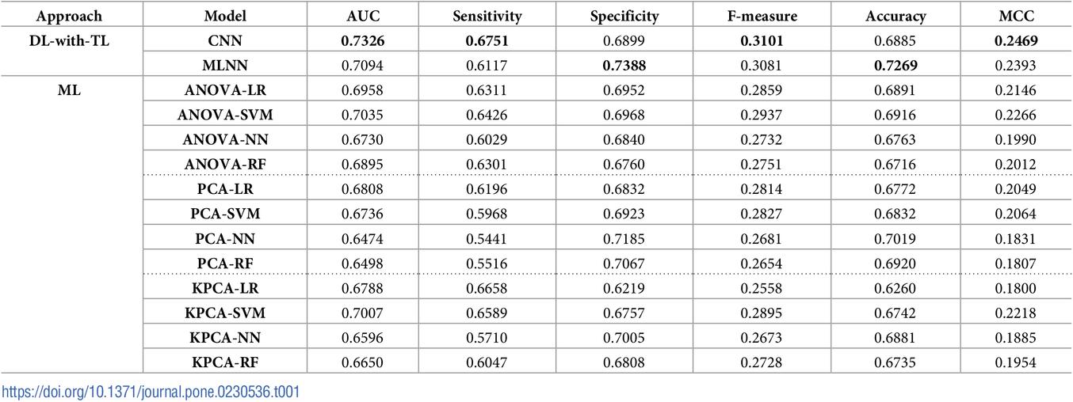
LUNG CANCER
13
Transfer learning with convolutional neural networks for cancer survival prediction using gene-expression data
Goal : predict lung cancer PFI outcome on gene-expression data.
https://journals.plos.org/plosone/article?id=10.1371/journal.pone.0230536

Slide 16
COLORECTAL CANCER

Slide 17
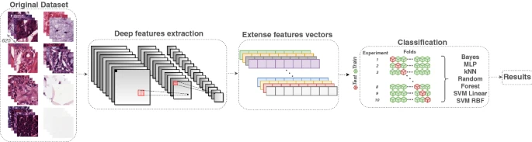
COLORECTAL CANCER
15
A novel transfer learning approach for the classification of histological images of colorectal cancer
Goal : classify tissue images of colorectal cancer histology in eight classes.
Author | Number of images | Approach | Method | Results
Our approach | 5000 | Feature extraction using CNNs through transfer learning, and then, classification with machine learning methods | DenseNet169 + SVM (RBF) | Acc: 92.08%F1-Score: 92.12%Error rate: 7.9%
Wang et al. [53] | 1000 | Decomposed the H&E components, and then, applied a BCNN-based to classify the decomposed images | Decomposition + BCNN | Acc: 92.6%
Rachapudi and Devi [37] | 5000 | A new CNN architecture | CNN with five blocks of layers | Error rate: 22.7%
Kather et al. [25] | 5000 | Feature extraction combining traditional feature extraction methods, and then, classification with machine learning methods | Combination of feature extractiontechniques + SVM (RBF) | Acc: 87.4%Error Rate: 12.6%
https://link.springer.com/article/10.1007/s11227-020-03575-6

Slide 18
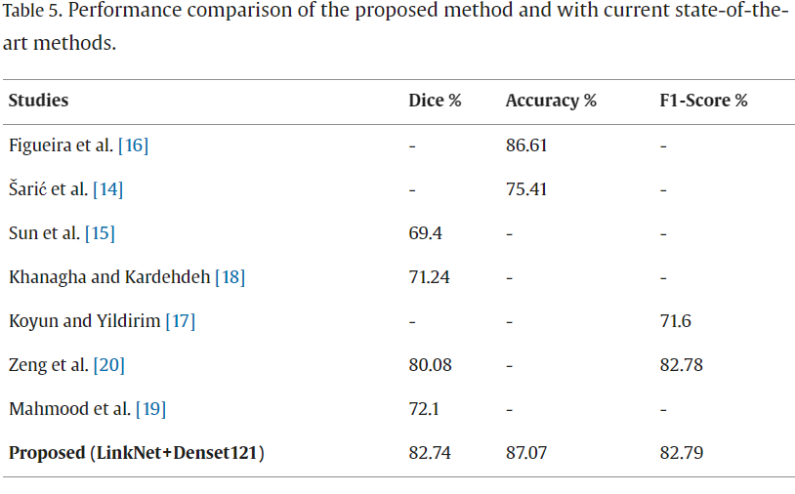
COLORECTAL CANCER
16
Deep transfer learning based model for colorectal cancer histopathology segmentation:
A comparative study of deep pre-trained models
Goal : compares various pre-trained deep learning models, particularly Convolutional Neural Networks (CNNs) and Transformer-based architectures, for their effectiveness in tumor segmentation
https://www.sciencedirect.com/science/article/pii/S1386505621002951

Slide 19
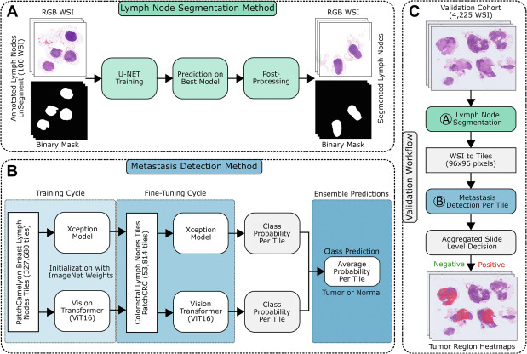
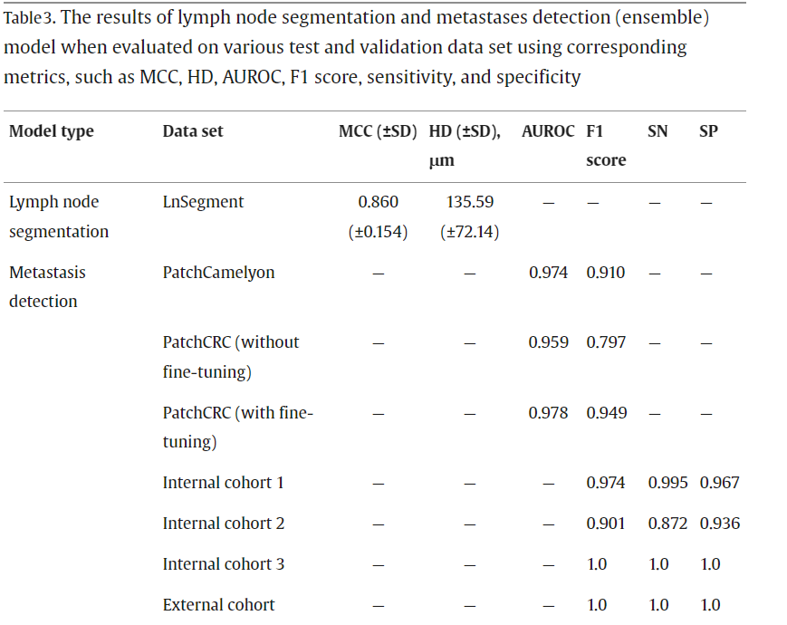
COLORECTAL CANCER
17
Computer-Assisted Diagnosis of Lymph Node Metastases in Colorectal Cancers Using Transfer Learning With an Ensemble Model
Goal : create a robust computer-assisted diagnostic tool using artificial intelligence (AI) to streamline the detection of lymph node metastases in CRC
https://www.sciencedirect.com/science/article/pii/S0893395223000236

Slide 20
THANK YOU

